Slide 1
NELLIP
Intercultural Horizons Conference,
Siena, 7 October 2013
Network of Language Label Projects and Initiatives

Slide 2
The Funding Programme
The NELLIP project is funded in the Framework of the Lifelong Learning Programme – Key Activity 2 Multilateral Networks action.

Slide 3
The Context: The European Language Label
The European Language Label (ELL) is awarded to the most innovative language learning initiatives developed thoroughout Europe
http://ec.europa.eu/languages/european-language-label/index_en.htm
Notes:
The European Language Label is an award for quality initiatives in the field of language teaching and learning. Every year, the European Language Label is awarded to the most innovative language learning initiatives in each European country The European Language Label is co-ordinated by the European Commission, but managed by National Agencies appointed in each Member States.
We will see in a few slides the awarding criteria established at European level

Slide 4
The Context: The European Language Label
Projects that received the European Language Label have therefore been assessed by experts representing the European Commission (i.e. the N.As) as quality language projects in Europe.
Notes:
Quality project in terms of
- being consistent with the needs of end users
- Fostering students motivation
- in terms of Innovation and creativity
- being based on a transnational approach
-

Slide 5
Objectives
The NELLIP network has 5 main objectives:
Reviewing projects that were awarded the ELL
Identification of Case Studies
Reporting Best Practice
Networking of ELL language learning initiatives
Production of Quality Guidelines

Slide 6
Results Achieved
.

Slide 7
Results
Database of Awarded Projects
Database of Case Studies
Report on Best Practice
Network of Language Learning Providers
Reports on the implementation of the ELL
Guidelines on language projects development

Slide 8
Database of Awarded Projects
Among the over 1200 projects that were awarded the ELL, 474 were selected by the NELLIP team, as they are in line with the current European political priorities in the field of Language Learning.
Focus on:
-The enhancement of quality of language learning.
- New approaches to language teaching and learning, TELL
- Language learning for specific purposes, VOLL
- Promotion of mobility
- Teachers training
- Promotion of multilingualism
- Promotion of less widely spoken languages
Notes:
TELL: Technically enhanced language learning
VOLL: Vocationally Oriented Language Learning
The most recent key documents on language learning are: The Council’s Conclusions on Language Competences to Enhance Mobility (2011), Strategic framework for cooperation on education and training (2009), EU strategy for multilingualism (2008), Multilingualism: an asset for Europe and a shared commitment (2008), Inventory of EU actions in the field of multilingualism(2008), Online consultation on multilingualism (2007), New framework strategy for multilingualism(2005).
The selected projects are also in line with the European criteria to award the ELL
- Consistency with the needs of end users
- Added value in terms of quality and quantity
- Fostering students motivation
- Innovation and creativity
- European dimension
- Transferability

Slide 9
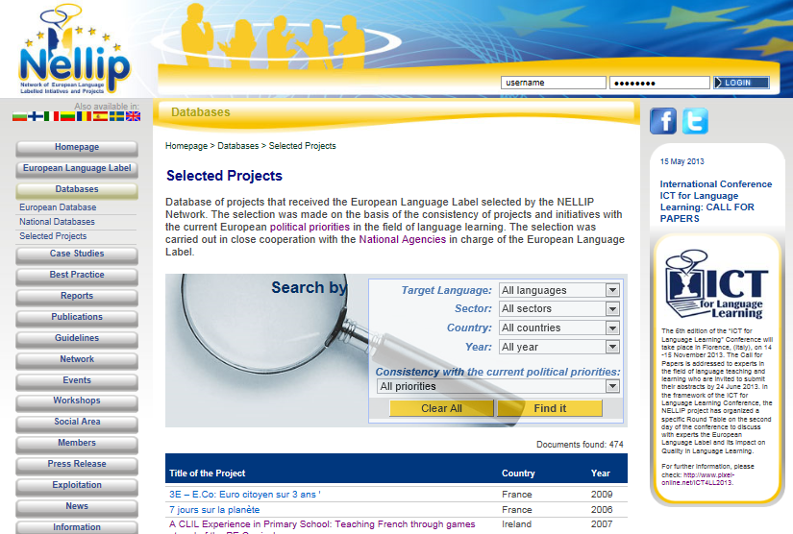
Database of Awarded Projects
Notes:
It is possible to carry out a search by target language, sector (school, uni etc), country.

Slide 10
Database of Case Studies
The National Agencies in charge of the ELL identified, among the awarded projects, a total of 200 Case studies in 18 European Countries.
The case studies were selected as the best among the quality projects that were awarded the ELL.
Telephone or personal meetings were organized with each coordinator of the selected initiatives and interviews were made.
Link to Case Studies

Slide 11
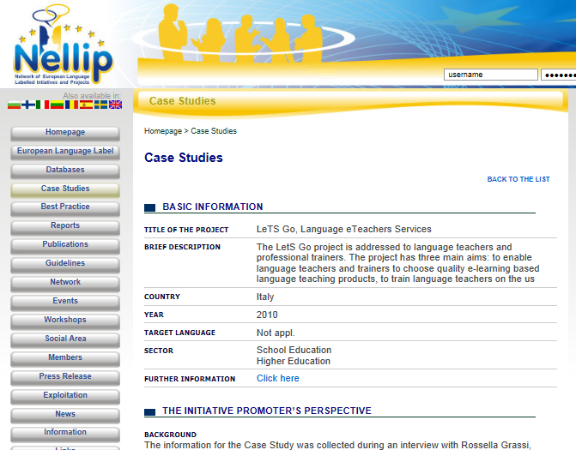
Database of Case Studies
Notes:
Every case study is organized as follows:
1) Context, Objectives, Approaches and Results
2) Impact of the ELL on the project
3) Quality Recommendations

Slide 12
Recommendation for Quality by awarded project promoters
Quality issues to be taken into account in the project development:
direct involvement of the target group
take into account what exists already and concentrate on innovative aspects
take into account criteria used to award the Label in the project planning
clear description of the product or method for the benefit of the end users.
test the deliverables produced and implement corrective actions
Involve organizations to support the project’s sustainability.
Notes:
The projects promoters of the projects that were awarded the label and that were object of the case studies in the 18 countries involved in this report were asked to provide recommendations to future applicants for the European Language Label.
According to the promoters of the awarded projects, in order to develop a quality language project that can successfully apply for the European Language Label, it is necessary to:
start from a direct involvement of the target group: the project can be a successful one if it addresses real needs. The final beneficiaries should be involved in the definition of the project objectives and activities so that the expected results will be consistent with their expectations.
take into account what exists already, i.e. do not re-invent the wheel, but rather build up and further implement existing quality products and methods for language teaching and learning (for example making reference to projects that were awarded the European Language Label).
concentrate on the innovative aspects on what is being develop and on how the project makes a difference for teachers and students.
develop the language project, taking into account some of the criteria used to award the Label, for example innovation and the transferability.
make a clear description of the product or method for the benefit of the end users, stating clearly who is the product/method addressed to, what are its objectives, what are the benefits for the users etc.
carry out a testing and assessment of the deliverables produced and implement a corrective action that takes into account the feedback of the end users involved in the testing.
Involve public bodies and organizations that can support the project’s sustainability.

Slide 13
Identification of Best Practice
Report on Best Practice identified in projects that were awarded the ELL:
Best practices refer to the 4 main target areas:
School Education
Higher Education
Adult Education
Vocational Education and Training
Link to Best Practices
Notes:
4 best practice project were selected in each country.
The selected initiatives are benchmarks to refer to in the planning of quality language learning projects that may successfully apply for the European Language Label.

Slide 14
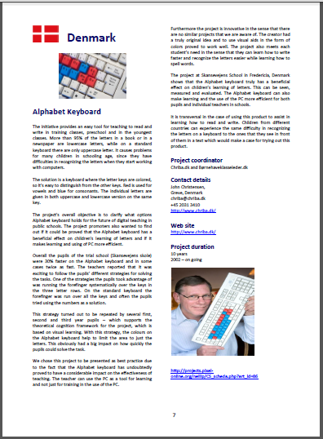
Identification of Best Practice

Slide 15
Examples of Best Practices 1/2
Database with 800 validated e-learning based sources for the learning of 18 languages
Collection of 300 e-learning experiences of language teachers
On line course on:
Selecting, Using, Creating
e-learning based language learning sources

Slide 16
Examples of Best Practices 2/2
On line courses for the learning of EN, FR, DE, IT, ES
Specific target group: secretarial and admin staff
Practical approach: games and simulations
9 Business Culture Modules
Portal available in 9 languages

Slide 17
Transnational Report on the ELL
Comparative transnational analysis of how the European Language Label is implemented throughout Europe.
Recommendations and best practices are also included. The report is available in 8 languages.
Notes:
Transnational Report on the Implementation of the European Language Label. The report presents a comparative transnational analysis of how the European Language Label is organized and managed throughout Europe. The transnational report provides quantitative and qualitative information on the projects that were awarded the European Language Label. The report also carries out a transnational assessment of the impact of the label on the awarded projects. Recommendations and best practices are also included. The report is developed on the basis of a comparative analysis of the National Reports produced. The report is available in eight different European languages.

Slide 18
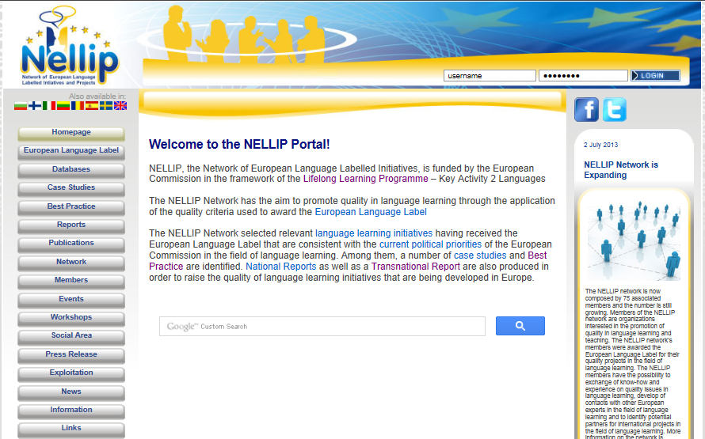
Guidelines on Quality
Target Sectors:
School Education
VET
Higher Education
Adult Education
Topics:
Quality in Language Learning
Exploitation of successful initiatives
Networking
References to ELL awarded projects

Slide 19
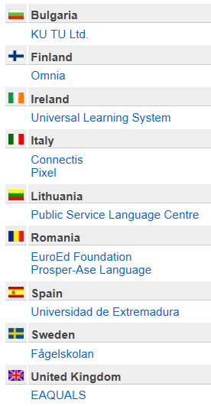
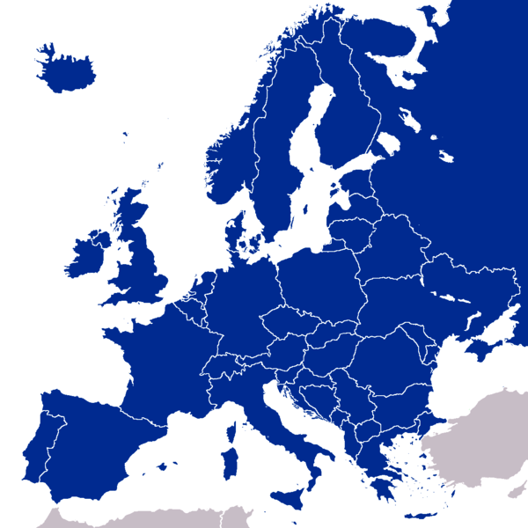
NELLIP Contractual Partnership
11 Partner Organizations
in 9 European countries

Slide 20
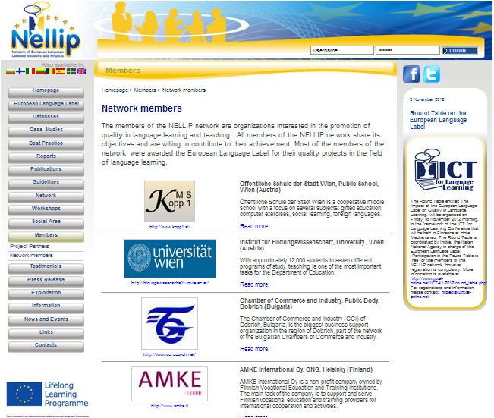
The Network, members
NELLIP is a network of 80 quality language learning providers based in Europe and beyond
(in progress).

Slide 21
The Network, Benefits
Participation in national workshops and international Events on quality in language learning.
Possibility to identify quality partnership for language projects among the network members
Exchange know-how and experience on quality issues in language learning and in participation in the European Language Label
Contribute to the defining of quality criteria in language learning.
Notes:
the possibility to attend, free of charge, a round table on Quality in Language Learning and the European Language Label (please see: http://www.pixel-online.net/ICT4LL2012/round_table.php),
special discounted rate for participating in the ICT for Language Learning International Conference in 2012, 2013 and 2014
participation in the national workshops on quality in language learning and the European Language Label to be organized as part of the project
access to the database of members of the international network so as to make contacts with European experts in the field of language learning and the European Language Label,
the opportunity to identify quality partnership for language teaching projects among the network members
the opportunity to exchange know-how and experience on quality issues in language learning and in participation in the European Language Label
an opportunity to contribute to the defining of quality criteria in language learning.

Slide 22
The Network on Facebook
NELLIP on Facebook has over 500 Friends
(in progress).

Slide 23
Future Activities: Workshops
November 2013 – April 2014
27 National Workshops for Experts in Language Learning on:
Quality
Exploitation
Networking
These will be organized in the 9 partner countries.
2 Transnational workshops organized in Florence, Italy, in the framework of the ICT for language Learning International Conference (Nov. 2013 and Nov. 2014)

Slide 24
The European Funding Programme
.

Slide 25
LLP, KA2, Languages
Objectives
Promotion of Language learning and linguistic diversity
Priorities 2013
Promotion of less widely spoken languages
Early language learning
Support bilingual education
Quality
Grant
150 000 € per year.
Up to 75% of the total costs

Slide 26
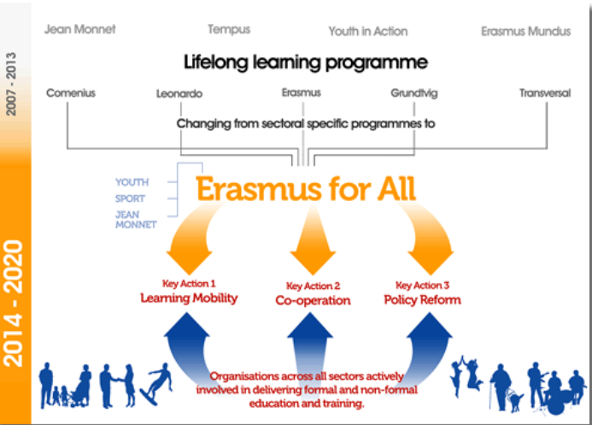
The Future: Erasmus Plus
Notes:
The new programme for the period 2014 – 2020
Erasmus+ has the same four strategic objectives as LLP (i.e. reference to Europe 2020)
Total budget: 16 billion euro for 7 years
The Programme covers the following fields:
education and training at all levels -> 78% of the budget
(b) Youth -> 10% of the budget
(c) Sport -> 2% of the budget
The Programme includes an international dimension aimed at supporting the Union's external
action, including its development objectives, through cooperation between the Union and
third countries.

Slide 27
Partnership with Pixel
We can be your partner if you are willing to submit a European Project
In the last 14 years have been involved over 70 projects funded by the EC
Notes:
Role: coordinator or partner in charge of management, quality issues, evaluation.

Slide 28
Thank you for the Attention
.
Elisabetta Delle Donne
Pixel, Firenze
eli@pixel-online.net
http://nellip.pixel-online.org/
Questions?

